Slide 1
LISTENING IN HUMAN COMMUNICATION

Slide 2
TOPIC OVERVIEW
Listening is a fundamental aspect of human communication and plays a crucial role in our ability to understand and connect with others
Involves the following Processes;
Receiving
Understanding
Remembering
Evaluating
Feedback

Slide 3
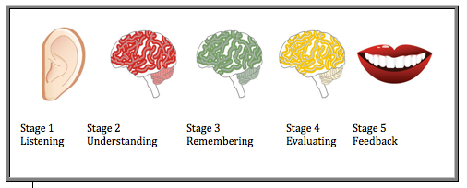
LISTENING IN COMMUNICATION

Slide 4
PROCESS OF LISTENING
HEARING /RECEIVING
Response caused by sound waves, physical, filter out other sources, isolate message At this stage, we are still only hearing the message.
UNDERSTANDING ; Stage of learning what the speaker means- the thoughts and emotional tone. we attempt to learn the meaning of the message, which is not always easy. For one thing, if a speaker does not enunciate clearly, it may be difficult to tell what the message was.

Slide 6
CHARACTERISTICS OF A GOOD LISTENER

Slide 7
Reflective Feedback: Provide constructive feedback and reflections when appropriate. Summarize the main points by the speaker to demonstrate that you have been actively listening and comprehending their message
Patience and Tolerance: Especially when discussing complex or sensitive topics. Avoid rushing the speaker. Allow them to express themselves fully and be respectful of their opinions, even if you disagree.
Open-Mindedness: Approach the conversation with an open mind, free from preconceived notions or biases. Be receptive to new ideas and perspectives, even if they differ from your own.

Slide 8
IMPORTANCE OF LISTENING
Personal growth
Problem solving
Effective communication
Building relationships
Conflict resolution
Effective leadership
Decision making

Slide 9
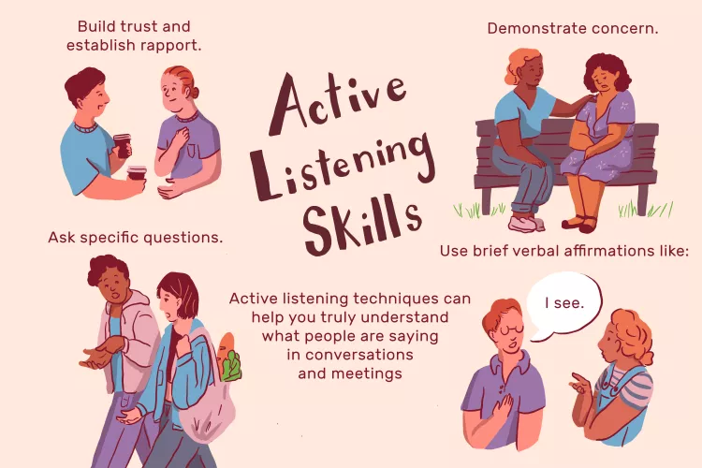

Slide 10
THANK YOU FOR LISTENING
QUESTIONS ARE MOST WELCOME

